Slide 1
Gene expression analysis of porcine whole blood cells infected with foot-and-mouth disease virus using high-throughput sequencing technology
Final Group Project
Lv J, Ding Y, Liu X, Pan L, Zhang Z, Zhou P, et al. (2018) Gene expression analysis of porcine whole blood cells infected with foot-and-mouth disease virus using high-throughput sequencing technology. PLoS ONE 13(7): e0200081.
Mercy Fakude
Fazhir Kayondo
Stephen Gray
Ann Murithi
Ceren Ordas

Slide 2

Background
A transcriptome analysis of whole blood from pigs infected with foot-and-mouth disease virus (FMDV) was performed using the paired-end Illumina sequencing technique to understand the interactions between the pathogen and its host cells.
Notes:
allows users to sequence both ends of a fragment and generate high-quality, alignable sequence data. Paired-end sequencing facilitates detection of genomic rearrangements and repetitive sequence elements, as well as gene fusions and novel transcripts.

Slide 3
Background
This study was the first transcriptome analysis of pig whole blood cells infected with FMDV.
120 differentially expressed genes (DEGs) were identified; 110 up-regulated genes and 10 down-regulated genes.
They looked at:
DEGs involved in interactions between the uninfected and uninfected pigs,
Gene ontology (GO) annotation
Kyoto Encyclopedia of Genes and Genomes (KEGG) enrichment
This study improves our understanding of the interactions between FMDV and host cells as well as the diagnosis and control of FMD.
Notes:
IS THE SLIDE TOO BUSY? - Ceren

Slide 4
Documentation
Our group used both Python and R.
GitHub repository -
README.md file will contain all relevant information about the figures.
Markdown file will contain the code/packages used to make the figues.
All the files needed/figures will be in the GitHub repository.

Slide 5
Materials and methods
12 animals- 6 non-infected, 6 infected
Whole blood samples collected from both groups 10 days post infection
12 libraries created
Conducted paired-end sequencing (100 base pairs)
Quality control of raw reads - FastQC
Differential expression analysis
Downstream gene ontology (GO) and KEGG gene analysis

Slide 6
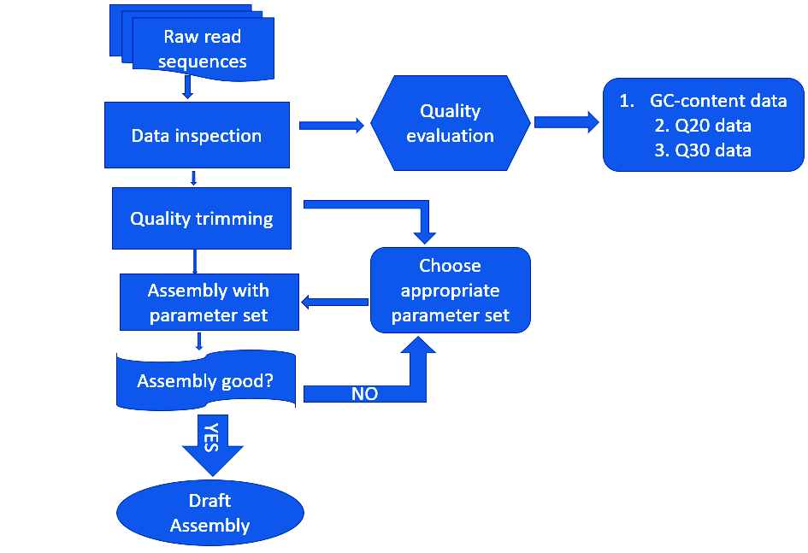
Pipeline used in data preparation and analysis

Slide 7
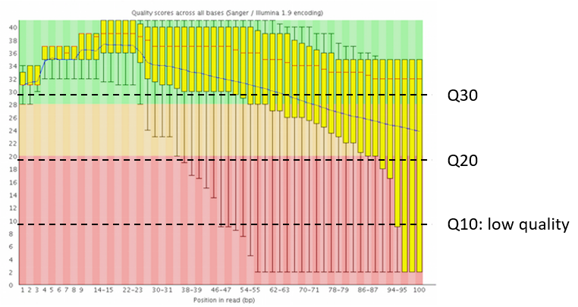
Per base sequence quality trimming
Trimmed off reads with
Adapter
poly-N
Low-quality (Q10)
Calculated Q20, Q30 and GC-content of clean reads
E.g., Q20 (%) is the percentage of reads with Q>20

Slide 8
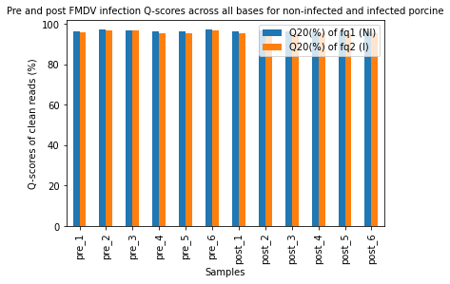
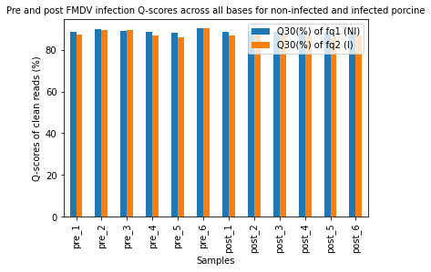
Quality scores across all bases

Slide 9
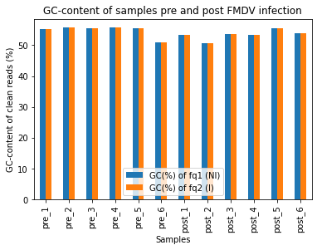
Total GC-content quality

Slide 10
Overview of the DE gene identified
Since the data provided give the information of the differentially expressed genes, plots were generated for comparison of the following groups of the DE genes
Comparison of up/Down regulated gene across treatments
The distribution of gene length
Comparison of up/down regulated genes from RPKM of infected and RPKM of non infected samples
Comparison of log2ratio against the gene length and their direction of regulation
Gene ID | Gene length | RPKM-Group NI | RPKM-Group I | log2Ratio(Group I/Group NI | Up-Down-Regulation(Group I/Group NI) | Probability
ENSSSCG00000026951 | 1013 | 29.2 | 1.68 | -4.119435231 | Down | 0.89635096

Slide 11
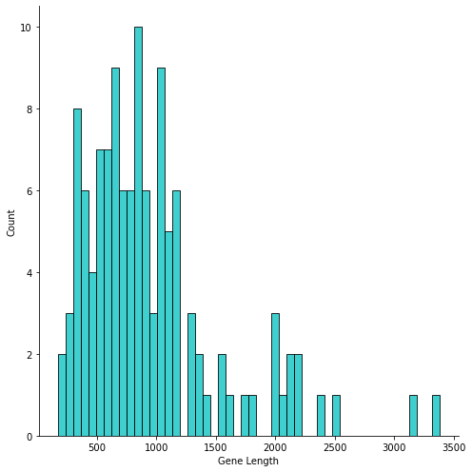
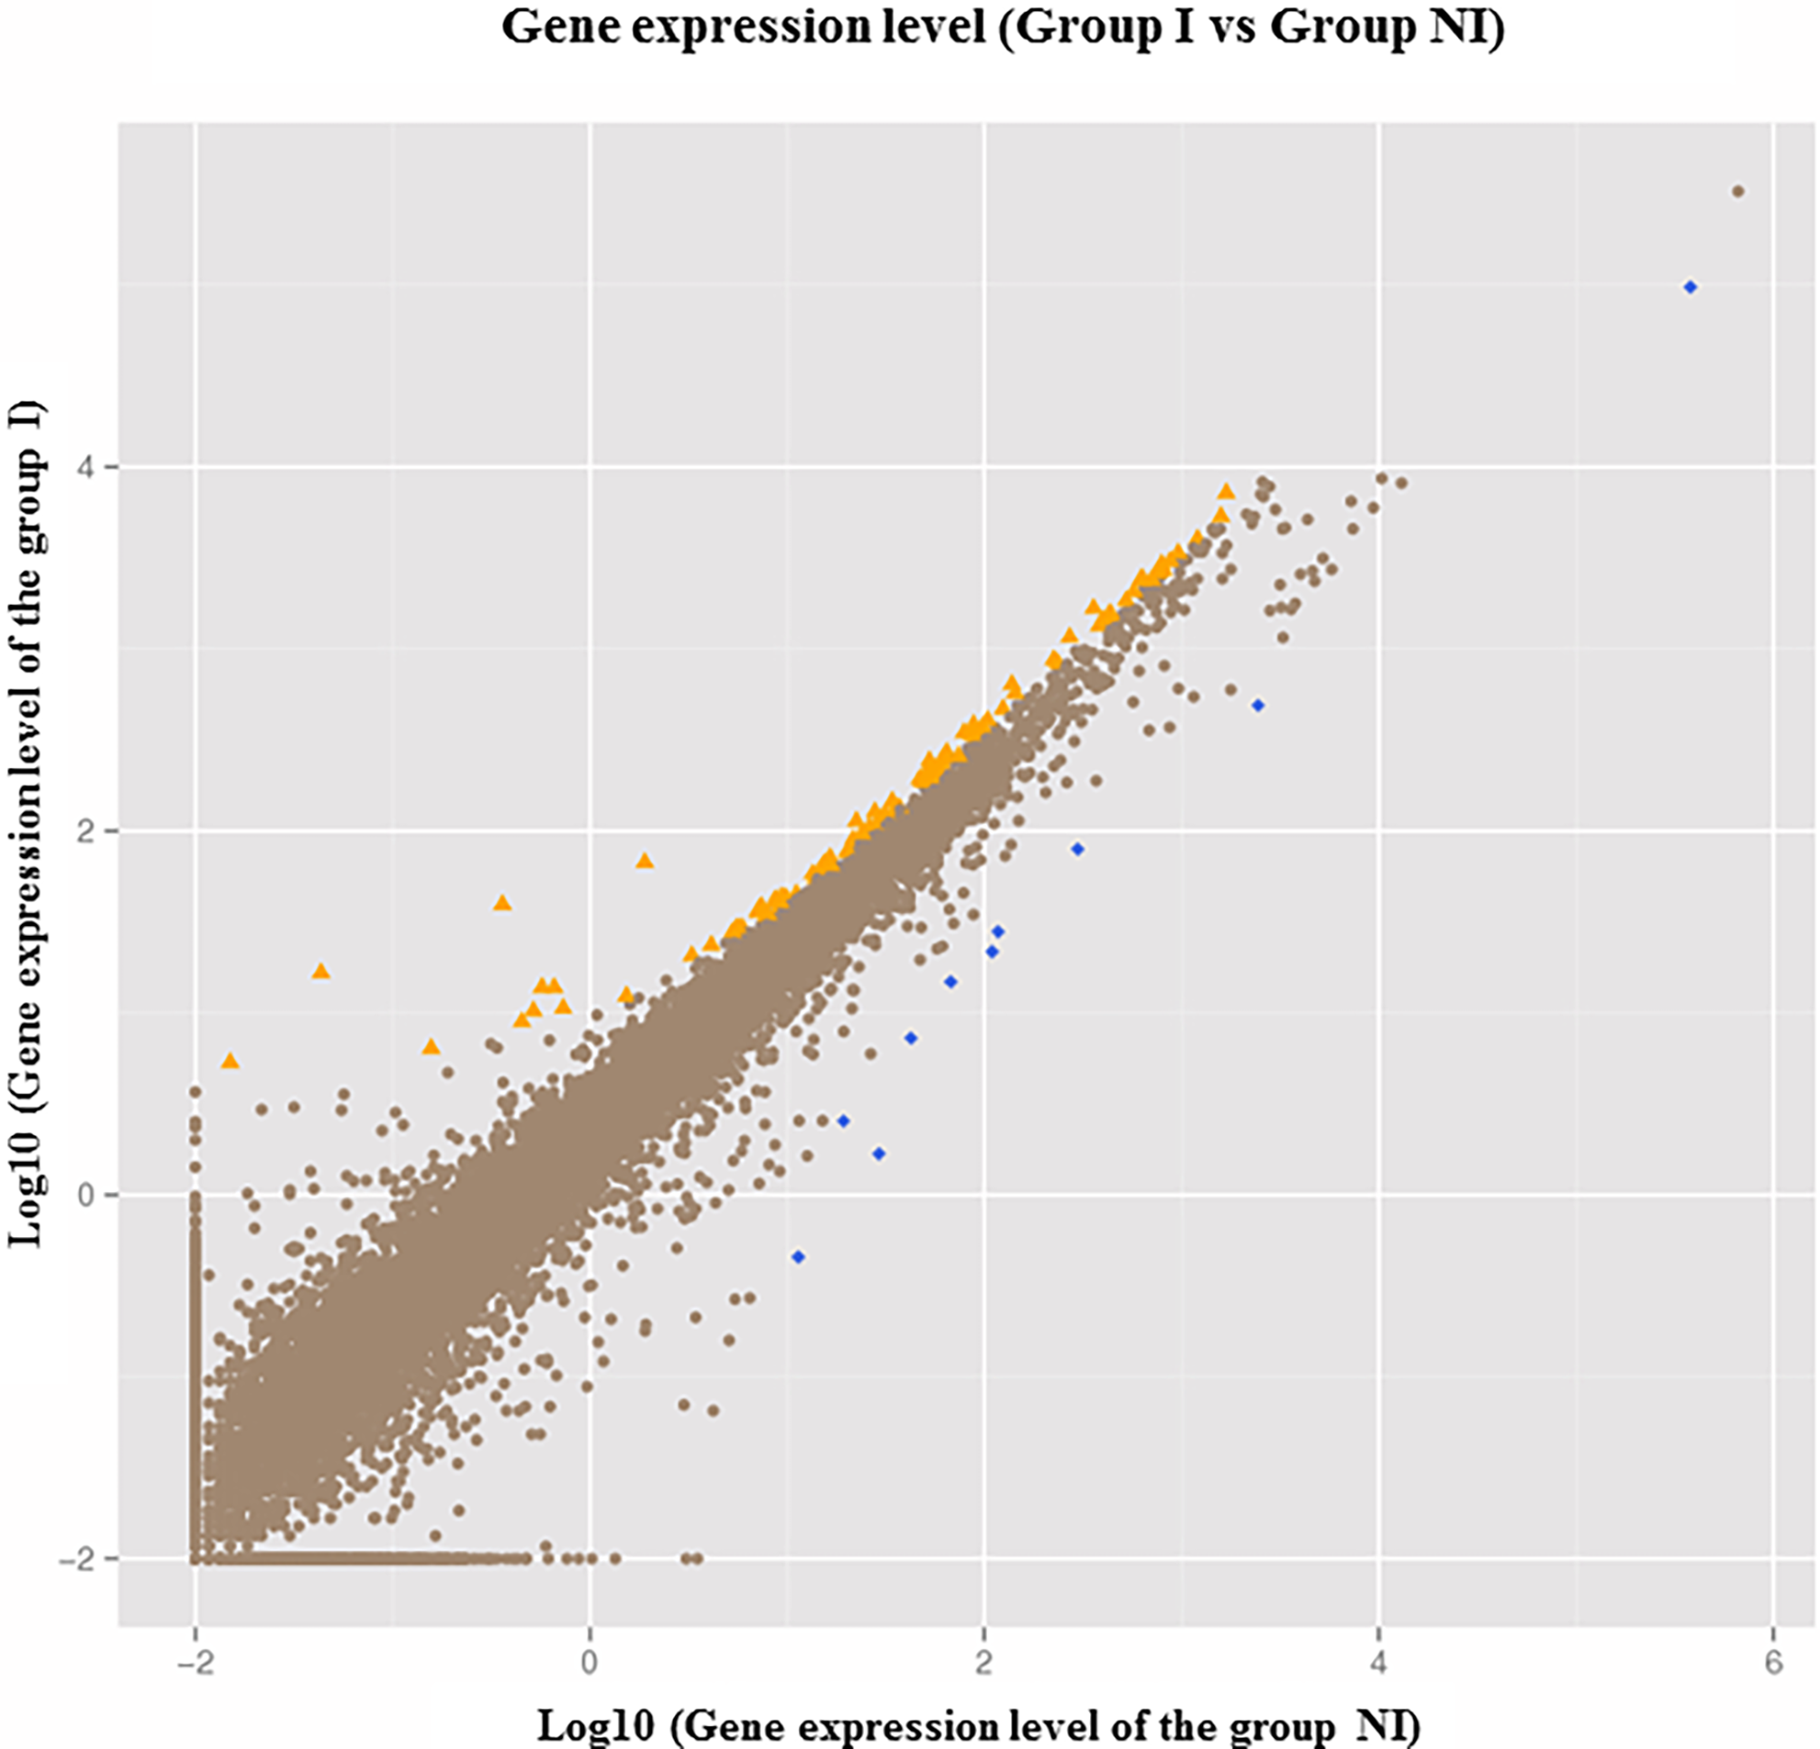
Comparison of DE genes across the treatments
Comparison of group levels between the I and the the NI groups
The distribution of gene length

Slide 12
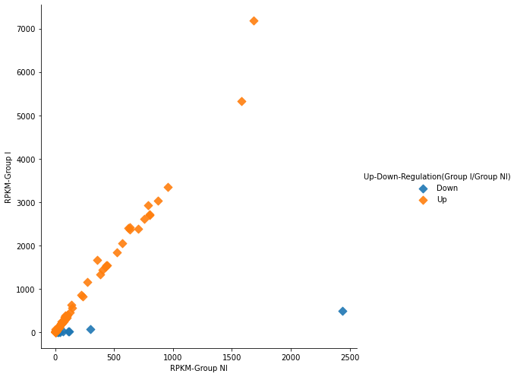
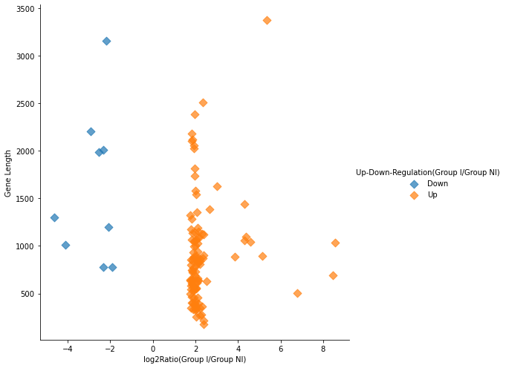
Comparison of DE genes across the treatments
RPKM(infected) vs RPKM(non-infected)
Log2Ration vs Gene Length

Slide 13
Gene Ontology Functional Classification
Gene Ontology breaks down behavior of genes into three domains
Molecular
Cellular
Biological
A gene will then be characterized by a “ functional term” within each domain
Gene A → Domain: Molecular Category → Term: Structural Constituent of Ribosome
While ontology aims to describe the function of a known gene it is possible that there is overlap between Molecular, Cellular, Biological Groups

Slide 14
Gene Ontology Functional Classification
For this project the goal was to categorize the genes into functional domains, and then further classify them by a functional term
Gene ID’s from paper→ Entrez IDs → DAVID database → Ontology Results
The DAVID Database will breakdown the Entrez IDs into functional classes (Biological, Cellular, and Molecular), and then designate a functional term to each gene
The occurrence of genes within multiple functional groups complicated the analysis

Slide 15
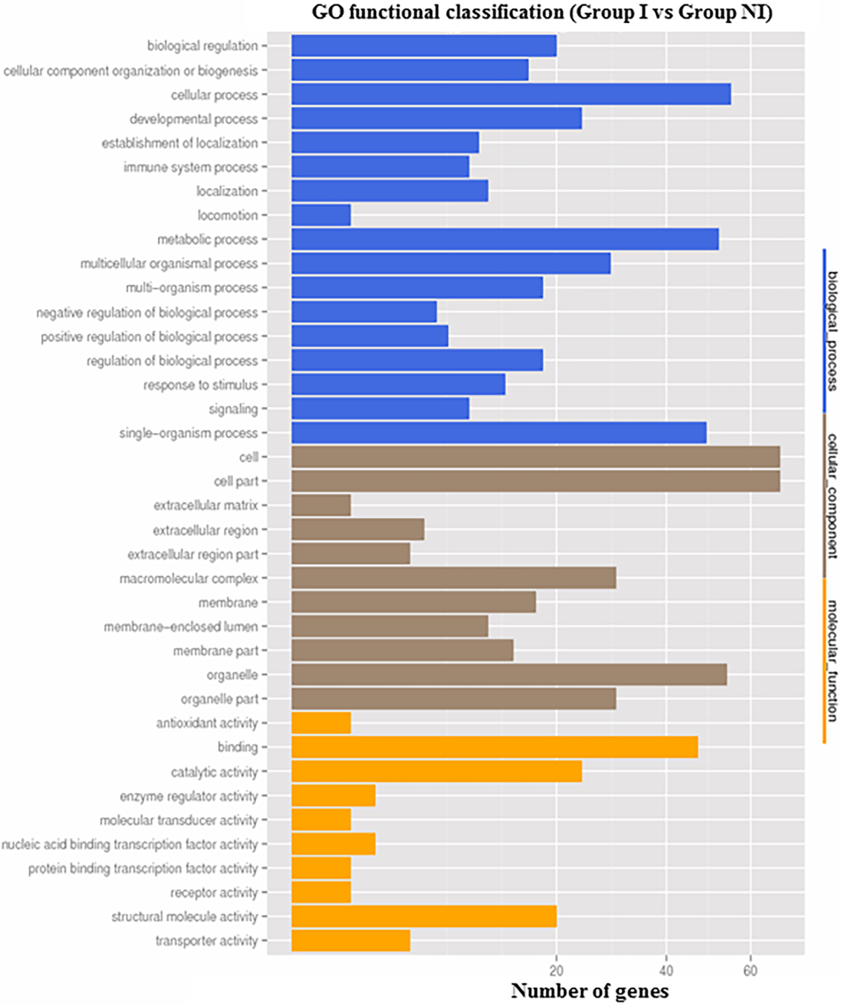
Gene Ontology Figures
Gene ontology graph from manuscript
Groups based on biological, cellular, and molecular domains
Within each group, a functional term is attributed to each gene ID, and the number of genes with each term is represented

Slide 16
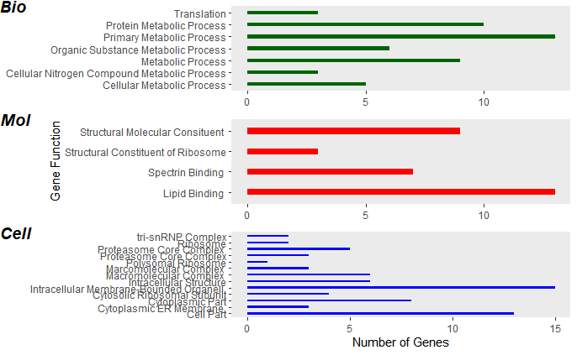
Gene Ontology Figures
Gene Ontology graph recreated in RStudio
Values differ as a result of conducting our own ontology evaluation based on Gene ID’s

Slide 17
KEGG Enrichment Analysis
What is KEGG?
Database resource for understanding high-level functions and utilities of the biological system, such as the cell, the organism and the ecosystem, from molecular-level information, especially large-scale molecular datasets generated by genome sequencing.
The DEG were used to carry out a Kyoto Encyclopedia of Genes and Genome (KEGG) pathway analysis and the KOBAS software was used to test the statistical enrichment of DEGs in KEGG pathways.
Why?
To identify biological pathways that are enriched in a gene list more than would be expected by chance.

Slide 18
Process
With the Gene ID’s provided, through the http://bioinformatics.sdstate.edu/go/ website, used ShinyGO 0.76 web application to get “Term Description”, “Fold Enrichment” and the “Genes” associated with each term description.
Data provided said whether these genes were upregulated or downregulated and their p-values.
Constructed a data on Excel with ““Term Description”, “Fold Enrichment”, “lowest p value”, “Upregulated Genes” and “Downregulated Genes”
Imported data to RStudio as “DataforEnrichment” and installed the pathfindR package.
> enrichment_chart(result_df = DataforEnrichment, top_terms = 20)
Notes:
1- download the only data available.

Slide 19
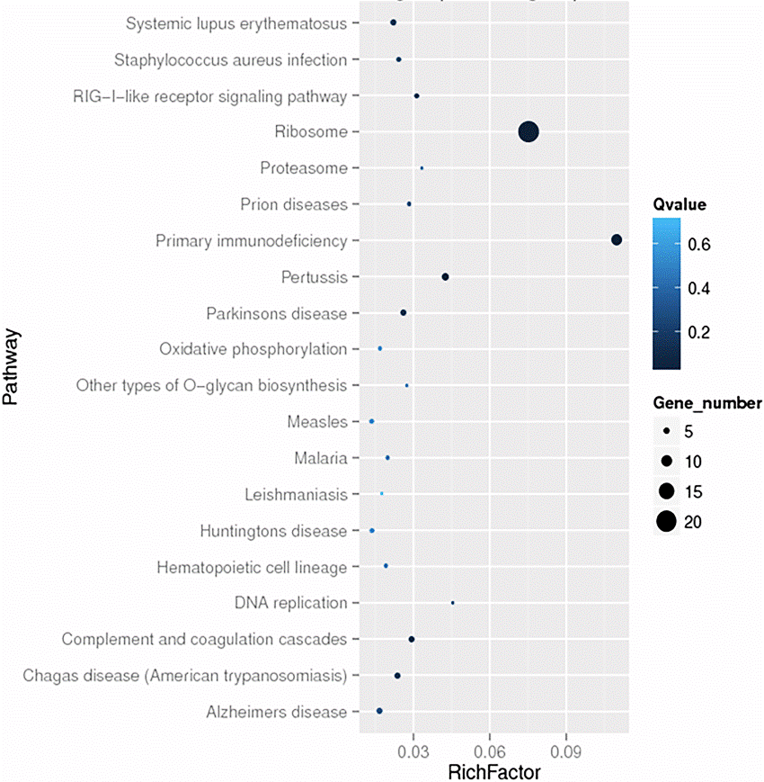
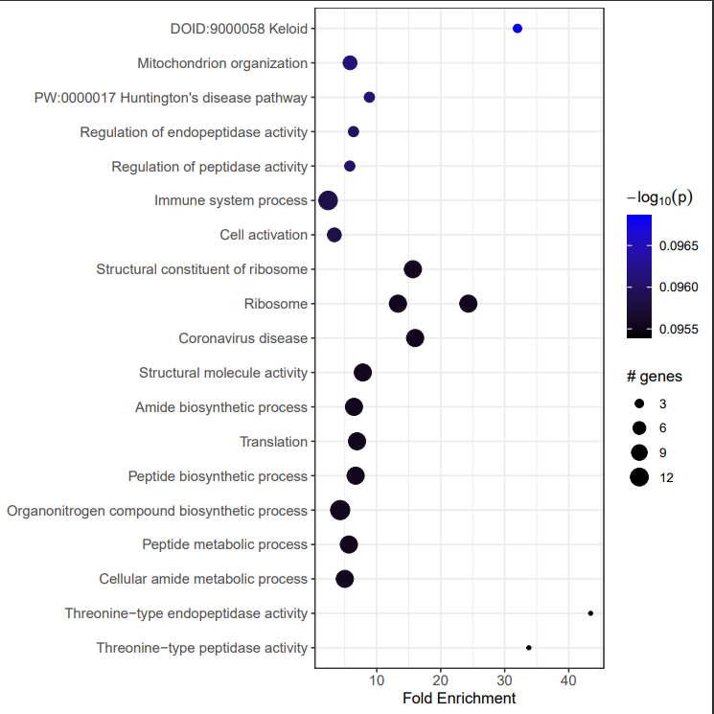
KEGG Enrichment Analysis: Paper vs Project

Slide 20
Validation of the expression of DEGs by qRT-PCR
This was a validation experiment conducted to randomly check if the genes obtained from the comparative analysis between the NI and I were actually differentially upregulated
The comparative experiment had been done in triplicates. Randomly samples NI_1, NI_3, NI_4, I_3, 1_4 and I_6 were selected for validation
The expression of 10 randomly selected genes was re-done through qPCR, using β-actin as the internal reference
Phosphate-Buffered Saline (PBS) injections were used as controls (expression values missing in data)

Slide 21
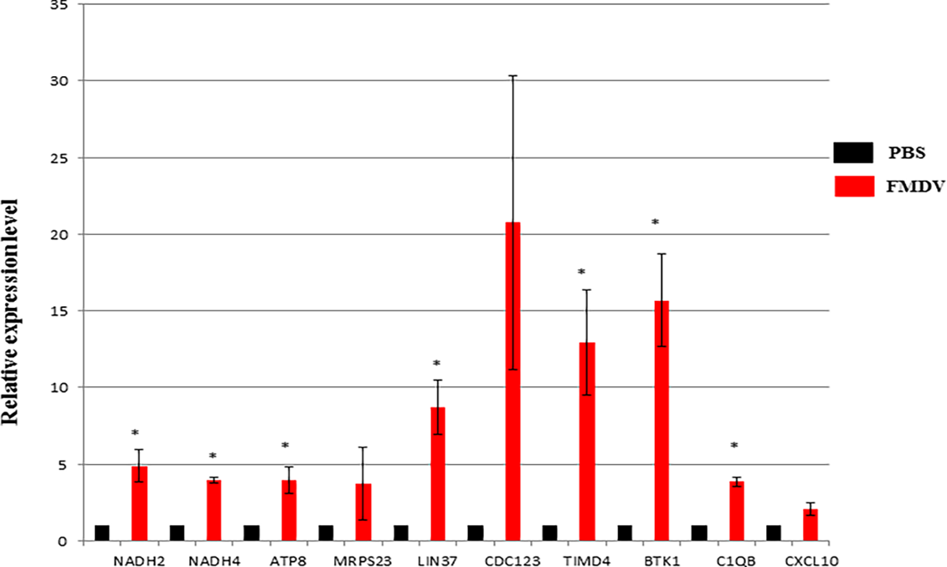
Results obtained
Selected gene | Fold change
NADH2 | Over 4
NADH4 | About 4
MRPS23 | About 3
LIN37 | Over 8
CDC123 | Over 8
TIMD4 | About 13
BTK1 | over 15
C1QB | About 4
CXCL10 | About 2
gene_name

Slide 22
Reproducing the relative expression
We downloaded the excel sheet with all the differentially expressed genes
2. We used the provided ENSEMBL geneID to produce a list of their corresponding gene names using Uniprot ID retriever. This yielded a few obstacles;
> Of the randomly selected genes in the paper, I could only retrieve IDs for NADH4, ATP8 and MRPS23
We randomly selected seven more from the list to make a list of 10 genes for this re-do
> We never had the values for the expression of PBS, which was used as a reference control
We utilized the description of fold changes in the paper to estimate this value as a 1 unit of RPKM (hence all our preceding relative expression values for the genes used the reference as 1 to compute fold change)

Slide 23
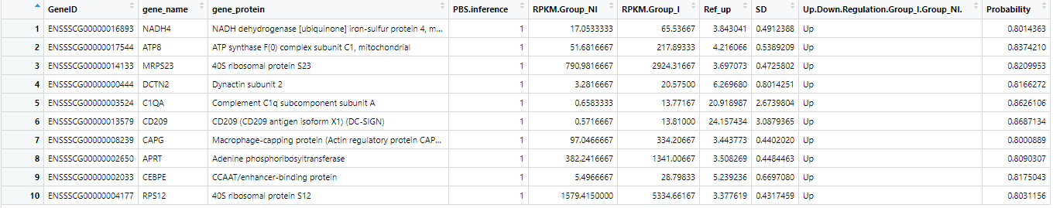
Validation of the expression of DEGs by qRT-PCR
We created a dataset names “Relative_expression.txt” using Microsoft Excel
We then created the plot using Plotly package of R version 4.1.3 using the code below
library(plotly)
project <- read.delim("Relative_expression.txt")
fig <- plot_ly(project, x = ~gene_name, y = ~Ref_up, type = 'bar', name = 'FMDV', marker = list(color = 'red'), error_y = list(array=~SD))
fig <- fig %>% layout(yaxis = list(title = 'Relative expression'), barmode = 'group', bargap = 0.20, bargroupgap = 0.45)
fig <- fig %>% add_trace(y = ~PBS.inference, name = 'PBS', marker = list(color = 'black'))

Slide 24
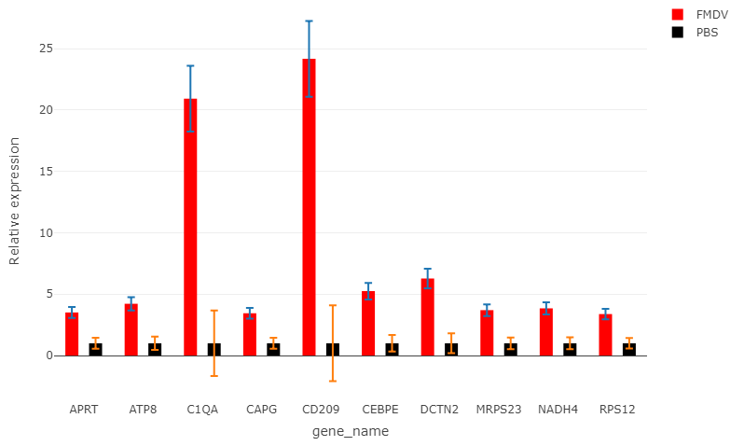
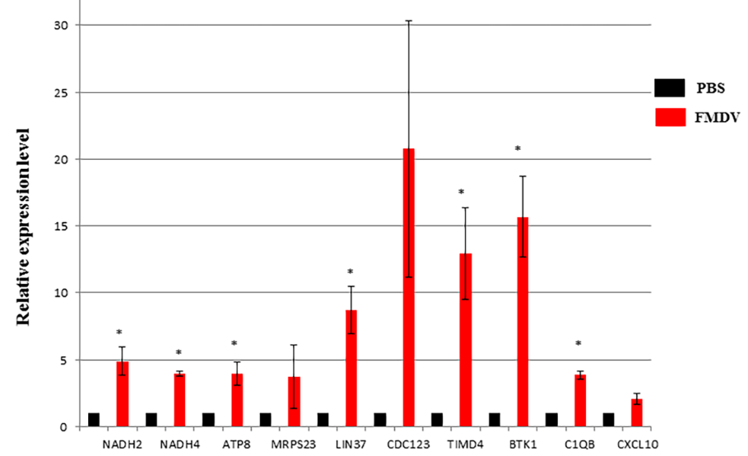
Resultant figure
Since we never had the actual reference values of PBS, we could not justify the fold change as significant or not.
We failed to eliminate the error bars from the reference bars by modifying our code. Any assistance will be highly appreciated !!!!!!!!

Slide 25
Conclusion
It was difficult to re-create the figures because we did not have some of the RAW DATA.
We had to piece together our own data from different sources or used different packages, etc.

Slide 26
QUESTIONS?

